Slide 1
TOPIC 17 EMPLOYMENT AGENCY
PROJECT PRESENTATION
Principles of Database Management
Lecturer: Dr. Nguyen Thi Thuy Loan
Group member: Vo Van Viet
Le Tran Minh Hoang
Le Bao Phuc

Slide 2
01
02
Overview
Diagram, Model
TABLE OF CONTENTS
03
04
Database – Querying
JDBC – Result
Motivation, about the project
Analyzing the topic, ER Diagram, Relational Model, Conceptual Schema
Database building, Querying using SQL, relation algebra
Connecting database to Java

Slide 3
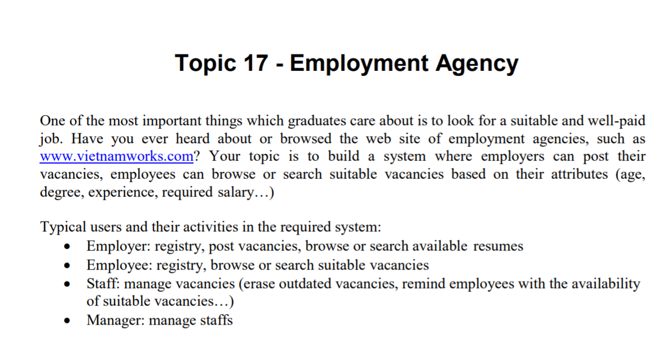
01. OVERVIEW
Big dream of every student after graduation
Platform for employees to post, search for job, and company looking for talented staff.

Slide 4
Analyzing the requirement
02. Diagram, Model
Employee: basic information, post resume, search job
Resume: some employee information
Staff: post vacancy, search for employee
Vacancy: information about the job
Company: company’s information
Relations: One-to-many, Many-to-many

Slide 5
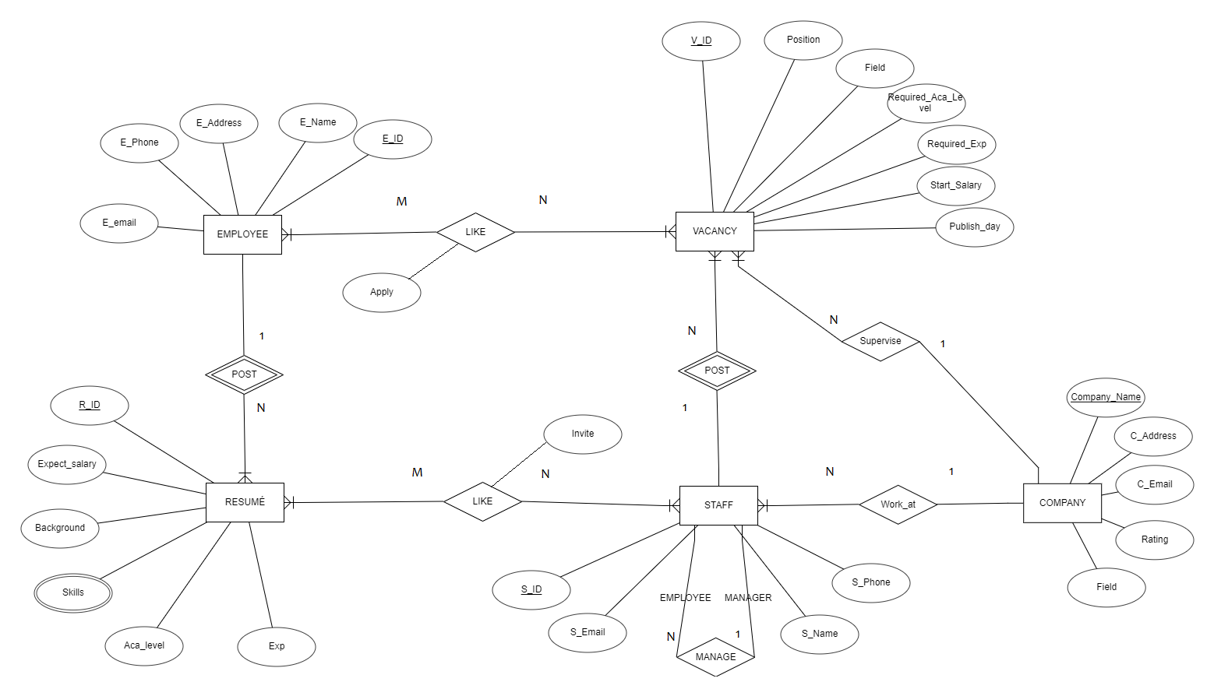
02. Diagram, Model

Slide 6
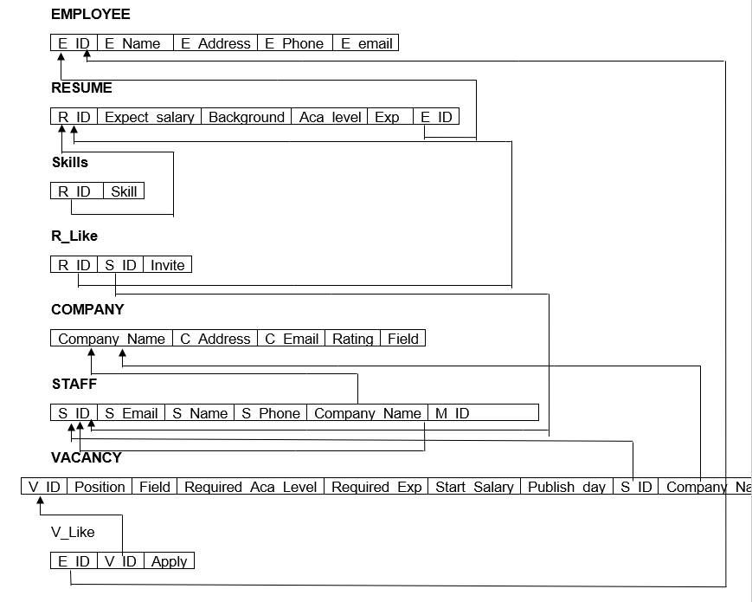
02. Diagram, Model

Slide 7
02. Diagram, Model
Employee = (E_ID, E_Name, E_Address, E_Phone, E_email)
Resume = (R_ID, Expected_Salary, Background, Aca_level, Exp, E_ID)
- From Resume.E_ID to Employee.E_ID
Skills = (R_ID, Skill)
- From Skills.R_ID to Resume.R_ID
R_Like = (R_ID, S_ID, Invite)
- From R_Like.R_ID to Resume.R_ID
- From R_Like.S_ID to S_ID
Company = (Company_Name, C_Address, C_Email, Rating, Field)
Staff = (S_ID, S_Email, S_Name, S_Phone, Company_Name, M_ID)
- From Staff.Company_Name to Company.Company_Name
- From Staff.M_ID to Staff.S_ID
Vacancy = (V_ID, Position, Field, Required_Ace_Level, Required_Exp, Start_Salary, Publish_day, S_ID, Company_Name)
- From Vacancy.S_ID to Staff.S_ID
- From Vacancy.Company_Name to Company.Company_Name
V_Like = (E_ID, V_ID, Apply)
- From V_Like.E_ID to Employee.E_ID
- From V_ID to Vacancy.V_ID

Slide 8
03. Database – Querying

Slide 9
04. JDBC - Result

Slide 10
CONCLUSION
Building a system of Employment Agency where employers can post their vacancies, employees can browse or search suitable vacancies based on their attributes.
Using: SQL Server, JDBC, knowledge from the course

Slide 11
THANKS!
Does anyone have any questions?

